Slide 1
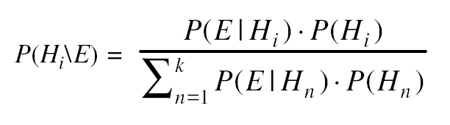
Bayes Theorem
The notion of conditional probability : P(H\E)
Let :
Bayes’ theorem then states that
Further, if we add a new piece of evidence, e, then

Slide 2
Adding Certainty Factors to Rules
Example of a Mycin Rule :

Slide 3
Measures of Belief

Slide 4
Combining Uncertain Rules

Slide 5
Combining Uncertain Rules
Goals for combining rules :
Since the order in which evidence is collected is arbitrary, the combining functions should be commutative and associative.
Until certainty is reached, additional confirming evidence should increase MB (and similarly for disconfirming evidence and MD).
If uncertain inferences are chained together, then the result should be less certain than either of the inferences alone.

Slide 6
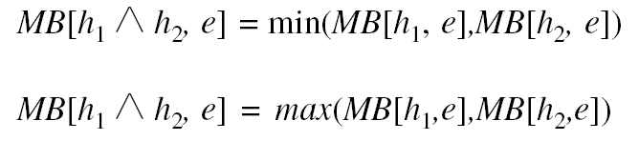
Combining Two Pieces of Evidence

Slide 7
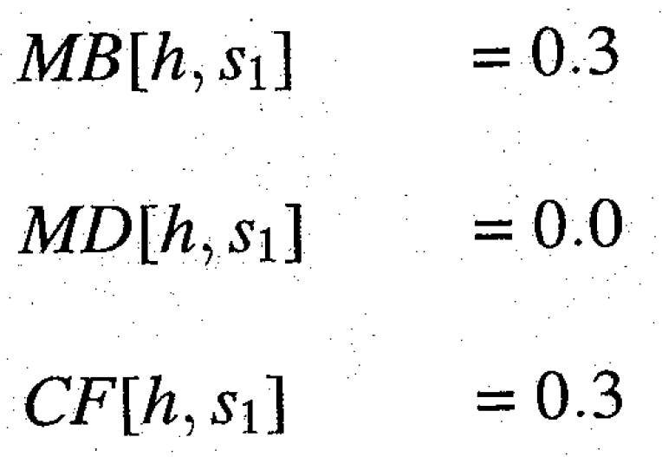
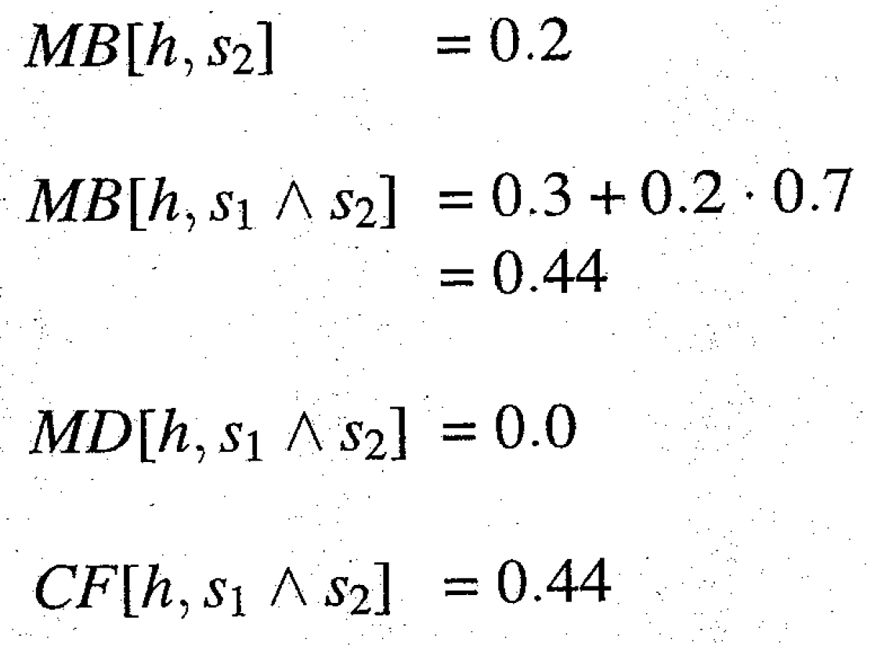
An Example of Combining Two Observations

Slide 8
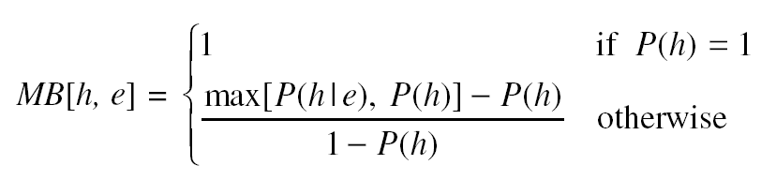
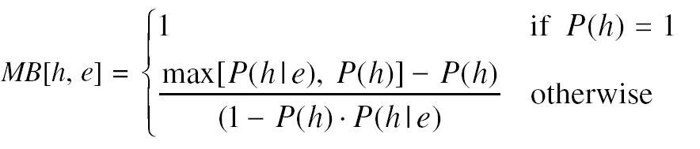
The Definition of Certainty Factors
Original definitions :
Similarly, the MD is the proportionate decrease in belief in h as a result of e:
But this definition is incompatible with Bayesian conditional probability. The following, slightly revised one is not :

Slide 9
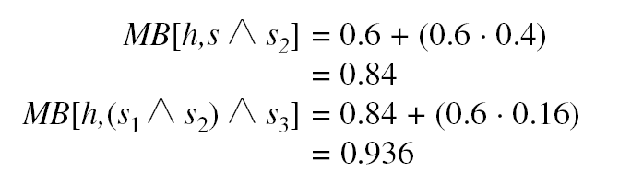
What if the Observations are not Independent
Scenario (a) :
This is very different than 0.7.

Slide 10
What if the Observations are not Independent
Scenario (c) :
Events :
So Sprinkler made us believe rain.

Slide 11
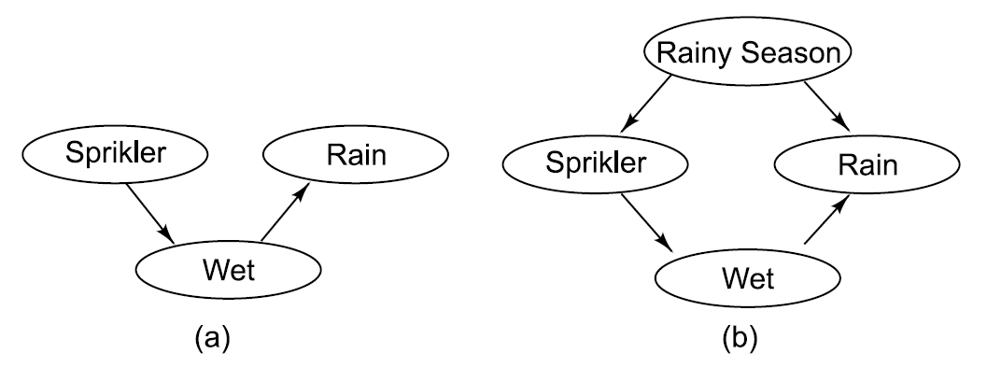
Bayesian Networks : Representing Causality Uniformly

Slide 12
Conditional Probabilities for Bayesian Network

Slide 13
Dempster -Shafer Theory
We consider the interval :
Plausibility (Pl) is defined to be :
Let the frame of discernment be an exhaustive, mutually exclusive set of hypothesis.
Let m be a probability density function.
We define the combination m₃ of m₁ and m₂ to be

Slide 14

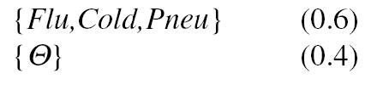
Dempster - Shafer Example
Let be :
All : allergy
Flu : flu
Cold : cold
Pneu : pneumonia
When we begin, with no information m is :
Suppose m₁ corresponds to our belief after observing fever.
Suppose m₂ corresponds to our belief after observing a runny nose.

Slide 15
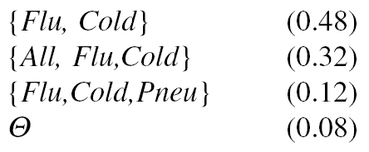
Dempster - Shafer Example (Cont’d)
Then we can combine m₁ and m₂ :
So we produce a new, combined m₃ :
Suppose m₄ corresponds to our belief after that the problem goes away on trips :

Slide 16
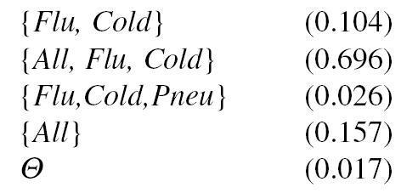
Dempster - Shafer Example (Cont’d)
Then we can combine m₁ and m₂ :
Normalizing to get rid of the belief of 0.54 associated with
gives m₅ :

Slide 17
Fuzzy Logic
Suppose we want to represent :
John is very tall.
Mary is slightly ill.
Sue and Linda are close friends.
Exceptions to the rule are nearly impossible.
Most Frenchmen are not very tall.

Slide 18
Fuzzy versus Conventional Set Membership

